Slide 1
INTERNSHIP @ Illinois INSTITUTE OF TECHNOLOGY
Name : MIHIR PANCHAL
Roll no : T118
SAP ID : 57498200018

Slide 2


About the institute
Illinois Institute of Technology is one of the prestigious research institutes in Chicago, USA.
Every Month Illinois Institute of Technology admits 60-80 students from round the globe for its virtual internship.
The main purpose of Illinois Institute of Technology is to embark new modernized skills to the students pursuing computer science in the 21st century.
Illinois Institute of Technology has provided a virtual internship in “Data Visualization” stream and a job role is as a “Data Analyst” in the internship.

Slide 3
Timeline of internship
Week 1 : Introduction and overview to the internship and project team.
: Review of sponsor’s data and business problem.
Week 2 : Uncovering the challenge question and collecting further information.
: Professional and personal skills development.
Week 3 : Conducting relevant research and creating a preliminary analysis.
: Preparing a draft report on the proposed solutions.
Week 4 : Group presentation on findings and recommendations for challenge questions.
: Reflective video on internship journey.

Slide 4

TASK ASSIGNED
Collect raw data from the finance team of Illinois Institute of Technology.
Remove anomalies and inconsistency in the raw data.
Clean the data by creating a pandas data frame and applying data cleaning algorithm.
Export the data to a .csv and visualize it in Tableau.
Generate Data Visualizations and create insights and predictions about the ad campaigns.
Convey and explain insights and predictions to the marketing team of Illinois Institute of Technology.

Slide 5


TEAM BUILDING
Mihir Panchal - Team Leader
Represents the team and communicates between the finance and marketing team, overall team representation, develop team strategy.
Kyle Pingue, Lily Watson- Project Managers
Provides guidance and draws out insight from other team members, ensures that the project execution remains on track.
Gunnika Singh, Noor Tantawy - Project Scribe
Responsible to taking meeting minutes and distributing notes/assignments. Can assist Team Lead in drafting emails and communication between sponsor and group.
Natalia Bartela- Project Lead
Responsible for holding the group accountable for meeting deadlines and ensures that the project deliverables are being met.

Slide 6






Technology USED

Slide 7
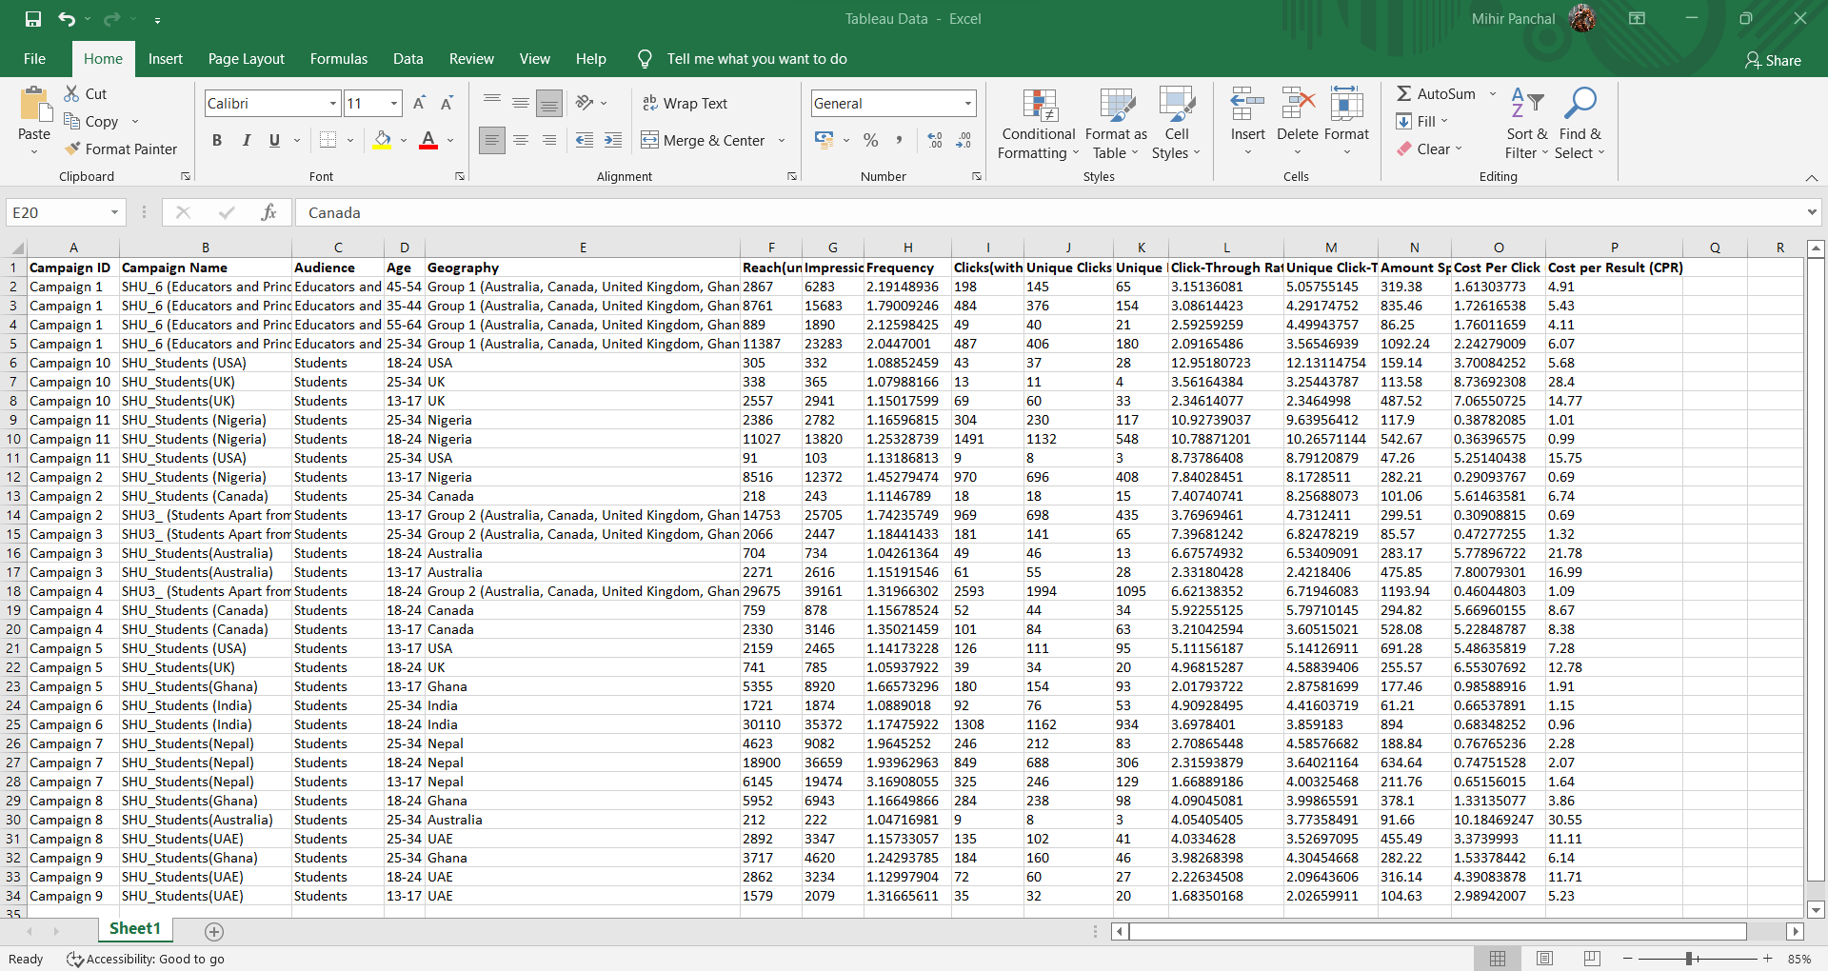
RAW DATA

Slide 8
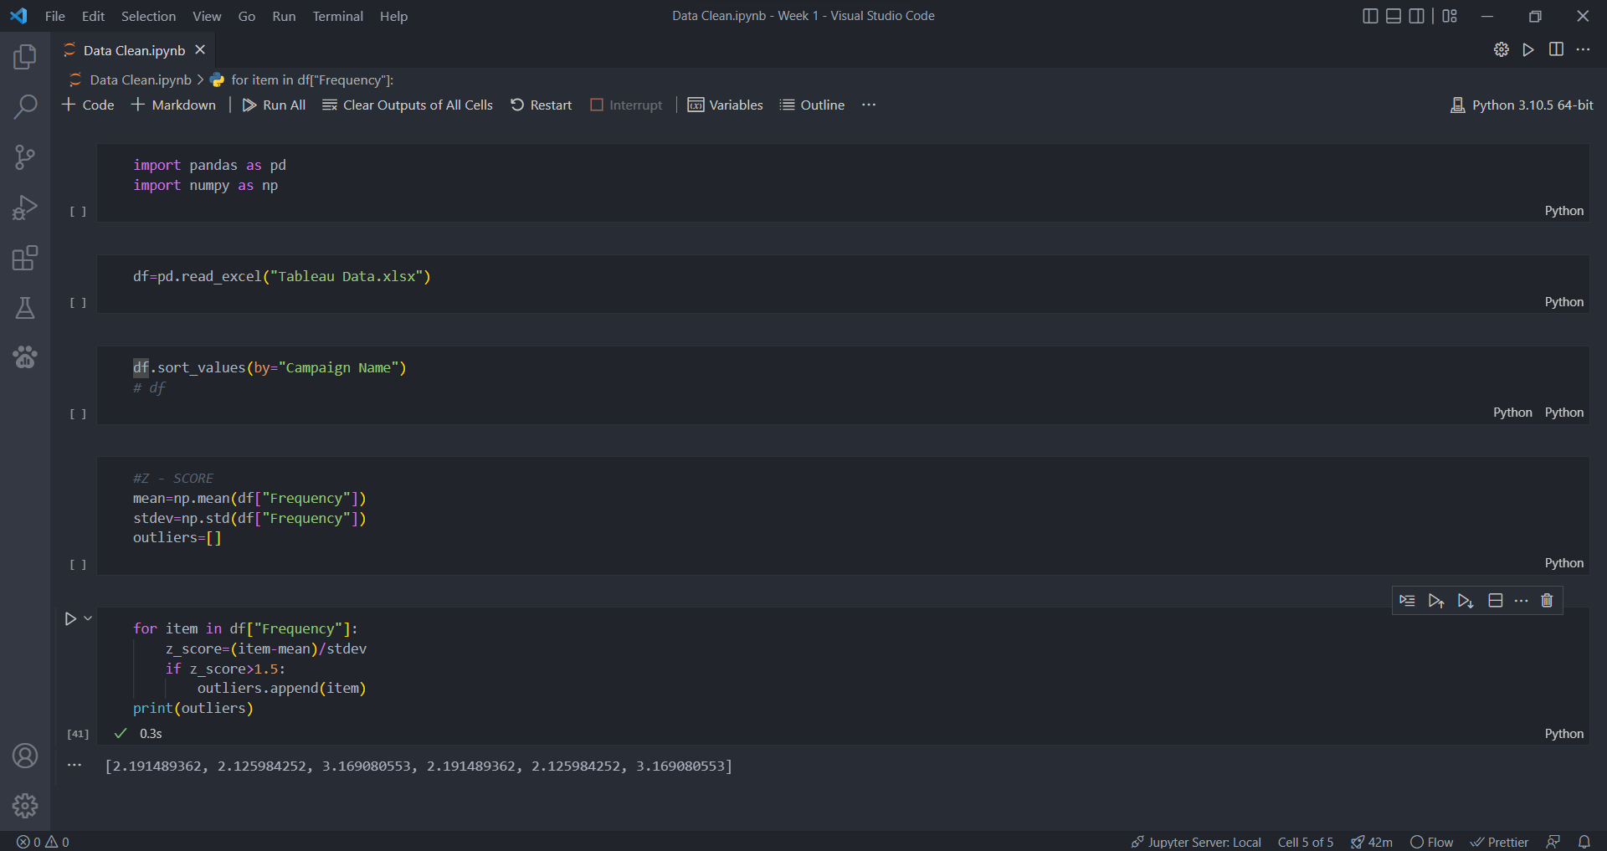
DATA CLEANING

Slide 9
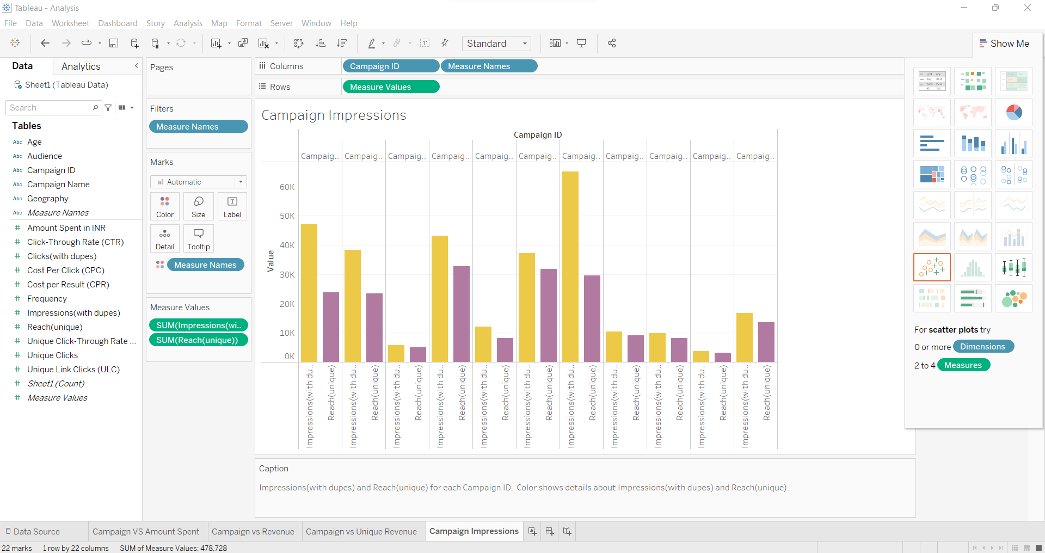
TABLEAU

Slide 10
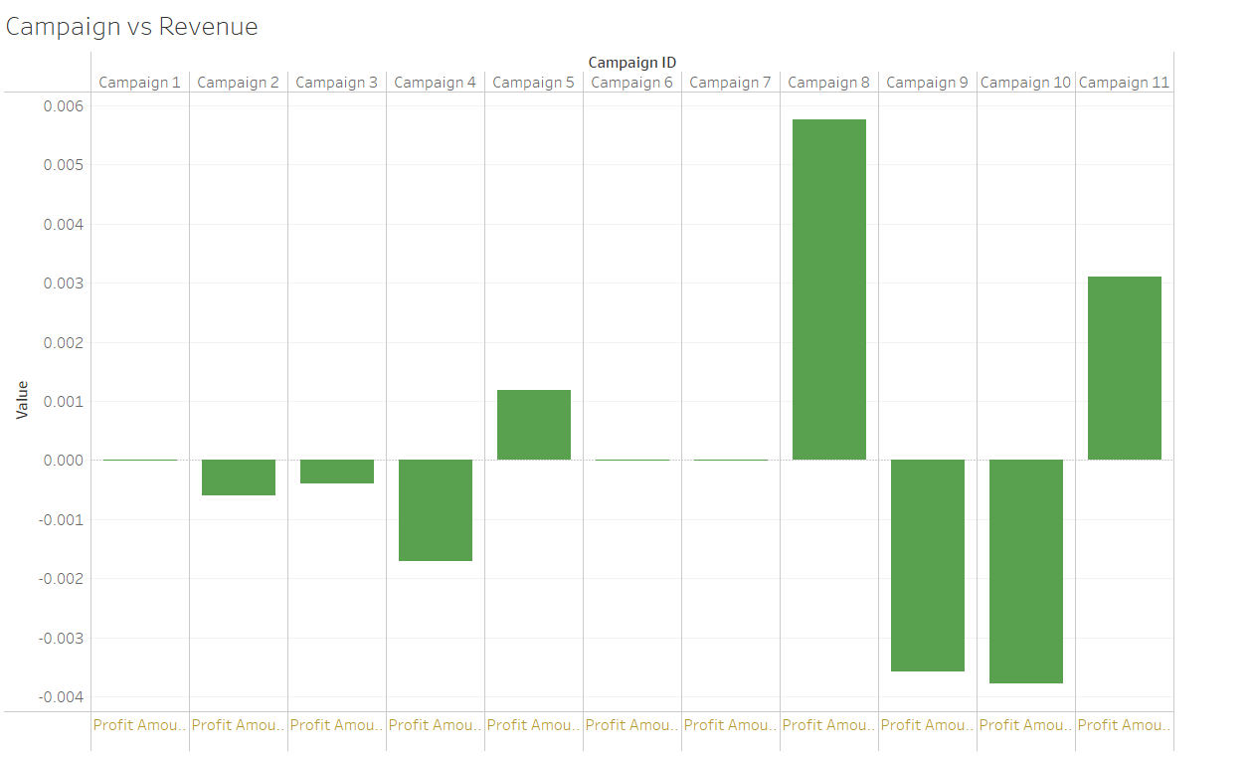
Data visualizations

Slide 11
DEVELOPING INSIGHTS AND Presentation
Insights and predictions about each campaign were noted and discussed with the team.
Discussions about discontinuing any one of the ad campaigns were discussed.
Presentations supporting our decision and its explanation will be presented with the marketing team of Illinois Institute of Technology.
Future Prediction of the ad campaigns using machine learning will be presented.
Necessary decisions and suggestions will be put forth to improve business development of the ad campaigns by Illinois Institute of Technology.

Slide 12
Learnings and EXPERIENCES
Upgraded Skills in presentation and communication amongst the team.
Developed Skills in the field of Data Science and Analysis.
Acquiring a scholarship of 1000$ USD boosted up my confidence.
Got tons of experience by working in a team of International students.
Got the exposure as a Team Lead in a working environment.

Slide 13
CONCLUSION
Along with the internship, I learnt more about the work culture and environment of foreign countries.
Sub-dividing the tasks lead the team to achieve definitive but achievable goals.
Along with weekly tasks, self analysis and critical thinking assignments were useful to bring out the values of a Data Analyst.
The exposure of theoretical and practical knowledge made the virtual internship better in terms of academics and non academic terms.

